Slide 1


Ali AlBikawi
23/2/2022
Github: (https://github.com/bikawi )

Slide 2

Outline
Executive Summary
Introduction
Methodology
Results
Conclusion
Appendix

Slide 3
Executive Summary
Data was gathered from the public SpaceX API and the SpaceX Wikipedia page. The 'class' label column was created to categorize successful landings. SQL, visualization, folium maps, and dashboards were used to explore data. I compiled a list of relevant columns to use as features. Using a one hot encoding, all category variables were converted to binary. GridSearchCV was used to determine the optimum parameters for machine learning models after standardizing data. Visualize all of the models' accuracy scores.
Logistic Regression, Support Vector Machine, Decision Tree Classifier, and K Nearest Neighbours were the four machine learning models developed. With an accuracy percentage of around 83.33 percent, they all gave similar outcomes. All of the models overestimated the likelihood of successful landings. For better model determination and accuracy, more data is required.

Slide 4
Introduction
Project background :
Commercial Space Age is Here
Space X has best pricing ($62 million vs. $165 million USD)
Largely due to ability to recover part of rocket (Stage 1)
Space Y wants to compete with Space X
Problem:
Space Y tasks us to train a machine learning model to predict successful Stage 1 recovery

Slide 5


Slide 6
Methodology
Executive Summary
Data collection methodology:
Collecting data from SpaceX API and SpaceX Wiki Page and combining them.
Perform data wrangling
Classifying landing in two categories, successful(good outcome), and unsuccessful(bad outcome).
Perform exploratory data analysis (EDA) using visualization and SQL
Perform interactive visual analytics using Folium and Plotly Dash
Perform predictive analysis using classification models
How to build, tune, evaluate classification models

Slide 7
Data Collection
Data Collected by two processes combined with each other, the first one is SpaceX public API by requesting it, the second is from SpaceX Wiki page by web scraping the tables required for the project.
Next slides will show a flow chart of these two processes.

Slide 8
Data Collection – SpaceX API
Filtering the data
Dealing with missing data
SpaceX API Data Columns: FlightNumber, Date, BoosterVersion, PayloadMass, Orbit, LaunchSite, Outcome, Flights, GridFins, Reused, Legs, LandingPad, Block, ReusedCount, Serial, Longitude, Latitude
Github URL:
Applied-Data-Science-Capstone/Complete the Data Collection API Lab.ipynb at main · bikawi/Applied-Data-Science-Capstone (github.com)
Request
(SpaceX
API)
Get JSON File from API
Make a Dict. of relevant data
Normalize the JSON file to Dataframe
Use different API endpoint

Slide 9
Data Collection - Scraping
Request html from Wiki.
Convert Dict. To DataFrame
Wiki. Page Web scraping:
Flight No., Launch site, Payload, PayloadMass, Orbit, Customer, Launch outcome, Version Booster, Booster landing, Date, Time
Github URL:
Applied-Data-Science-Capstone/Data Collection with Web Scraping lab (review).ipynb at main · bikawi/Applied-Data-Science-Capstone (github.com)
Using beautifulSoup ‘html.parser’
Fill Dict. By iteration table cells
Find launch table from html
Create a Dict.

Slide 10
Data Wrangling
By creating a new column called “class” and as we see in our dataset the outcome feature have two-component: ‘Mission Outcome’, ’landing location’, the ‘class’ column has two values ‘1’ and ‘0’, successful and failure respectively
The value map :
True ASDS, True RTLS, and True Ocean (will take ‘1’)
False ASDS, False RTLS, False Ocean, None ASDS, and None None(will take ‘0’)
Github URL:
Applied-Data-Science-Capstone/Complete the EDA lab.ipynb at main · bikawi/Applied-Data-Science-Capstone · GitHub

Slide 11
EDA with Data Visualization
Perform Exploratory Data Analysis and Feature Engineering using panda and matplotlib on some variables such as FlightNumber, PayloadMass, launchSite, Orbit, Class, and Year
The plot that we use in our analysis :
Flight Number vs. Payload Mass, Flight Number vs. Launch Site, Payload Mass vs. Launch Site, Orbit vs. Success Rate, Flight Number vs. Orbit, Payload vs Orbit, and Success Yearly Trend
To compare relationships between variables and to decide if a relationship exists we used: Scatter plots, line charts, and bar plots so that they could be used in training the machine learning model

Slide 12
EDA with SQL
We can separate our steps into 5 steps :
loaded the dataset into DB2 Database
Connect our database in a notebook
Using SQL magic to Query our data
Getting a better understanding of our data
Queried info. About different relationships
Github URL:
Applied-Data-Science-Capstone/Complete the EDA with SQL lab.ipynb at main · bikawi/Applied-Data-Science-Capstone · GitHub

Slide 13
Build an Interactive Map with Folium
Mark all launch sites and show their status if success landing or failed and calculate the distance between a launch site to its proximities.
Key locations : Railway, Highway, Coast, and City.
This allows us to understand why launch sites may be located where they are. And to visualize the successful landing relatively to there location.
Github URL:
Applied-Data-Science-Capstone/Complete the Interactive Visual Analytics .ipynb at main · bikawi/Applied-Data-Science-Capstone · GitHub

Slide 14
Build a Dashboard with Plotly Dash
Our dashboard include two type of plot :
1- Pie Chart 2-Scatter Plot
Pie Chart: Pie chart can be selected to show distribution of successful landings across all launch sites and can be selected to show individual launch site success rates.The pie chart is used to visualize launch site success rate.
Scatter Plot: Scatter plot takes two inputs: All sites or individual site and payload mass on a slider between 0 and 10000 kg. The scatter plot can help us see how success varies across launch sites, payload mass, and booster version category.
Github URL :
Applied-Data-Science-Capstone/dash_interactivity.py at main · bikawi/Applied-Data-Science-Capstone · GitHub

Slide 15
Predictive Analysis (Classification)
Splitting the column label from datafram
Score models on split test set
Confusion Matrix for all models
Github Url :
Applied-Data-Science-Capstone/Machine Learning Prediction lab practice.ipynb at main · bikawi/Applied-Data-Science-Capstone · GitHub
Standardize the data to fit and transform
Use GridSearchCV on LogReg, SVM Decision Tree, and
KNN models
Barplot to compare scores of models
Apply
Train_test_split
Find optimal param.
GridSearchCV
(cv=10)

Slide 16
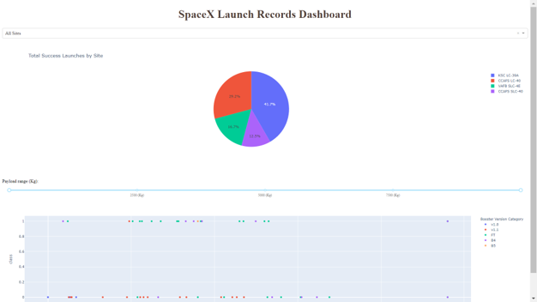
Results

Slide 17


Slide 18
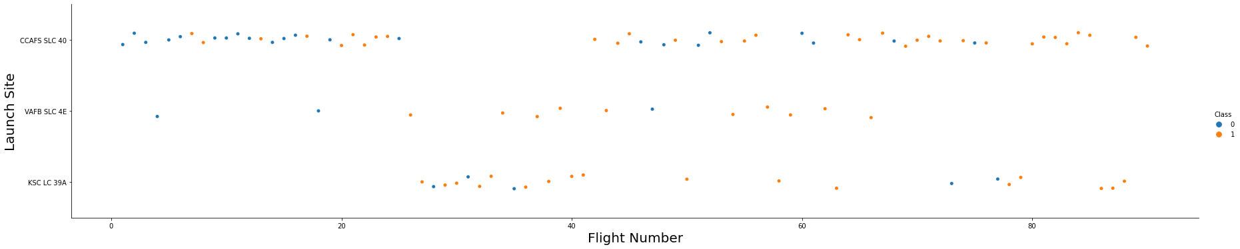
Flight Number vs. Launch Site
Show a scatter plot of Flight Number vs. Launch Site
Graphic suggests an increase in success rate over time (indicated in Flight Number). Likely a big breakthrough around flight 20 which significantly increased success rate. CCAFS appears to be the main launch site as it has the most volume.

Slide 19
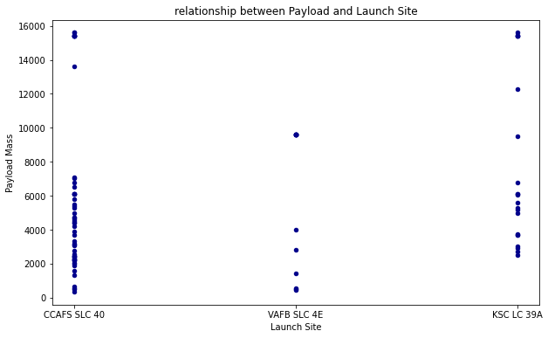
Payload vs. Launch Site
Show a scatter plot of Payload vs. Launch Site
Payload mass appears to fall mostly between 0-6000 kg. Different launch sites also seem to use different payload mass.

Slide 20
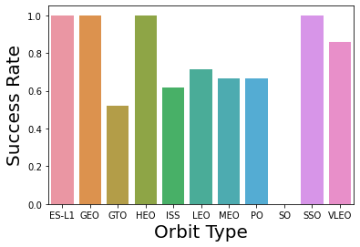
Success Rate vs. Orbit Type
Show a bar chart for the success rate of each orbit type
ES-L1 (1), GEO (1), HEO (1) have 100% success rate (sample sizes in parenthesis) SSO (5) has 100% success rate
VLEO (14) has decent success rate and attempts
SO (1) has 0% success rate
GTO (27) has the around 50% success rate but largest sample

Slide 21
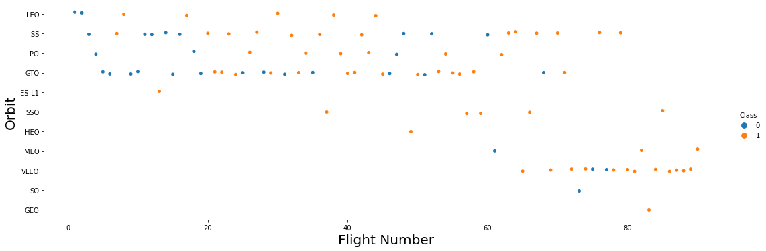
Flight Number vs. Orbit Type
Show a scatter point of Flight number vs. Orbit type
Launch Orbit preferences changed over Flight Number. Launch Outcome seems to correlate with this preference.
SpaceX started with LEO orbits which saw moderate success LEO and returned to VLEO in recent launches SpaceX appears to perform better in lower orbits or Sun-synchronous orbits

Slide 22
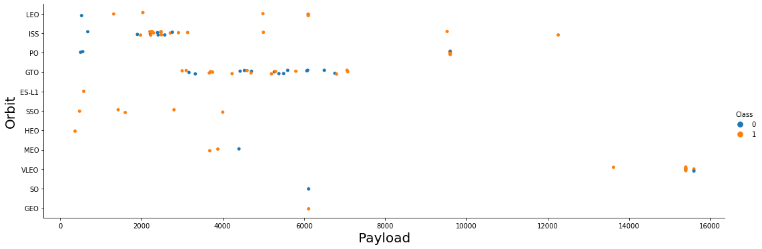
Payload vs. Orbit Type
Show a scatter point of payload vs. orbit type
Payload mass seems to correlate with orbit
LEO and SSO seem to have relatively low payload mass
The other most successful orbit VLEO only has payload mass values in the higher end of the range

Slide 23
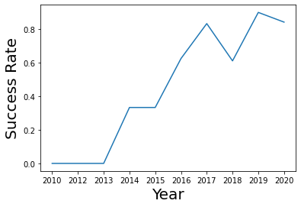
Launch Success Yearly Trend
Show a line chart of yearly average success rate
Success generally increases over time since 2013 with a slight dip in 2018
Success in recent years at around 80%

Slide 24
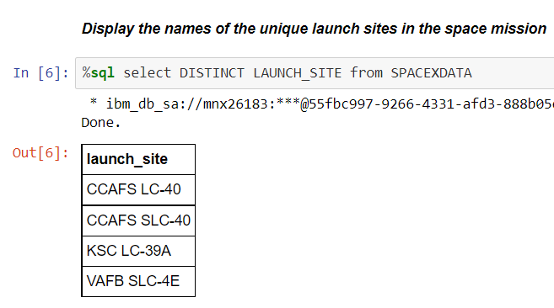
All Launch Site Names
Query unique launch site names from database.
CCAFS SLC-40 and CCAFSSLC-40 likely all represent the same
launch site with data entry errors.
CCAFS LC-40 was the previous name. Likely only 3 unique launch_site values: CCAFS SLC-40, KSC LC-39A, VAFB SLC-4E

Slide 25
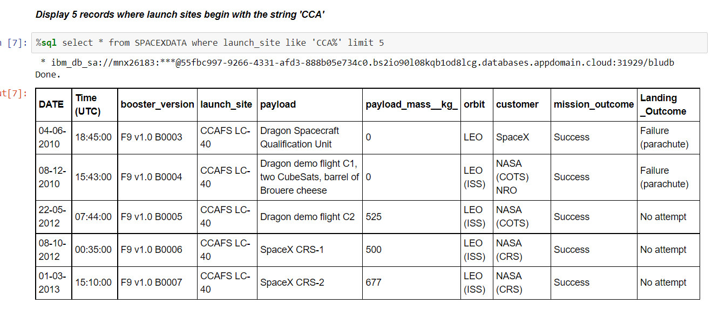
Launch Site Names Begin with 'CCA'
First five entries in database with Launch Site name beginning with CCA.

Slide 26
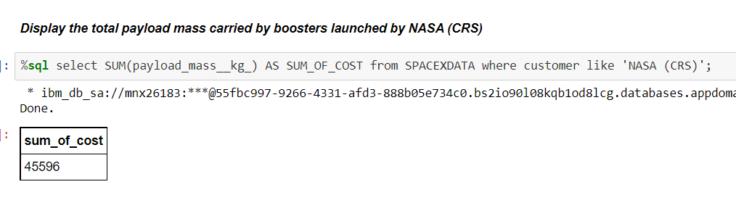
Total Payload Mass
This query sums the total payload mass in kg where NASA was the customer.
CRS stands for Commercial Resupply Services which indicates that these payloads were sent to the International Space Station (ISS).

Slide 27
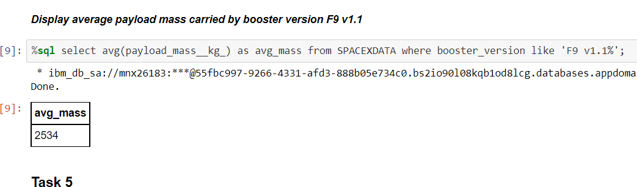
Average Payload Mass by F9 v1.1
This query calculates the average payload mass or launches which used booster version F9 v1.1
Average payload mass of F9 1.1 is on the low end of our payload mass range

Slide 28
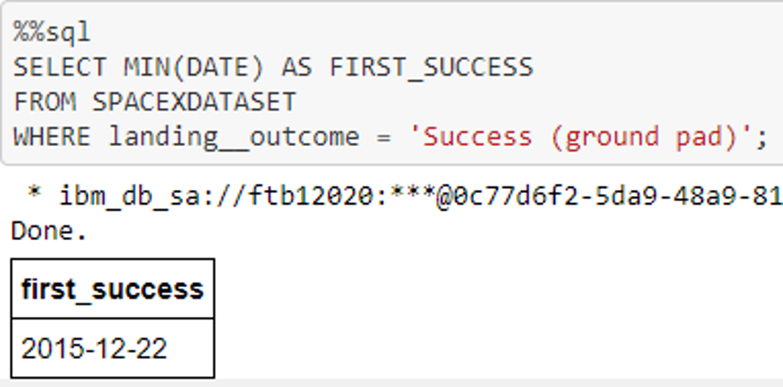
First Successful Ground Landing Date
This query returns the first successful ground pad landing date.
First ground pad landing wasn’t
until the end of 2015.
Successful landings in general
appear starting 2014.

Slide 29
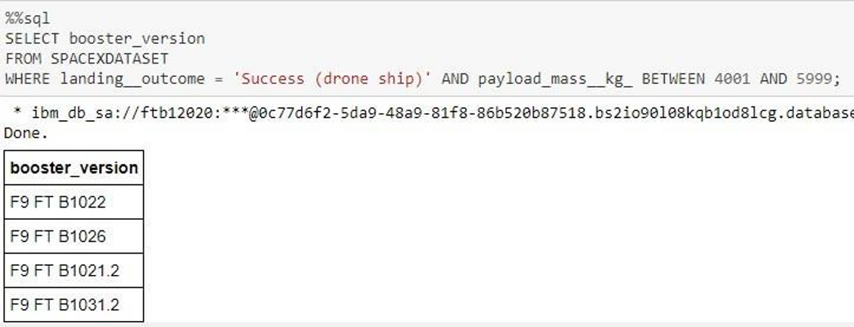
Successful Drone Ship Landing with Payload between 4000 and 6000
This query returns the four booster versions that had successful drone ship landings and a payload mass between 4000 and 6000 noninclusively.

Slide 30
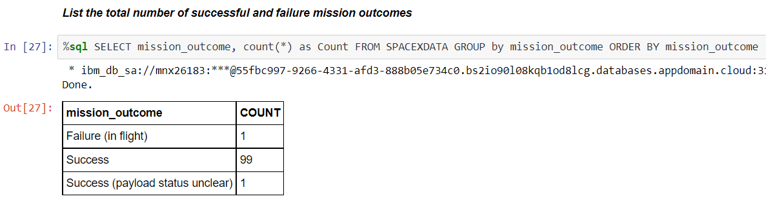
Total Number of Successful and Failure Mission Outcomes
This query returns a count of each
mission outcome.
SpaceX appears to achieve its mission outcome nearly 99% of the time.
This means that most of the landing
failures are intended.
Interestingly, one launch has an unclear payload status and unfortunately one failed in flight.

Slide 31
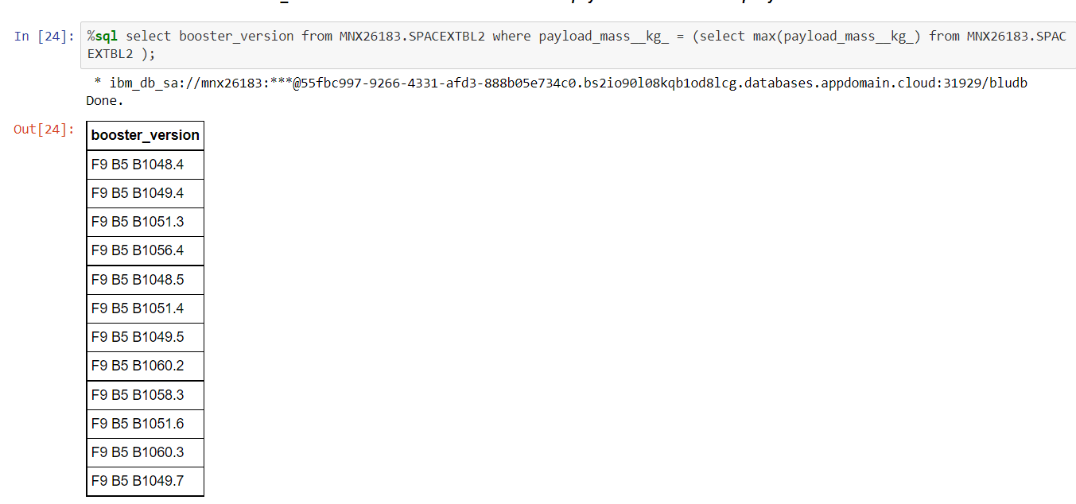
Boosters Carried Maximum Payload
This query returns the booster versions that carried the highest payload mass of 15600 kg.
These booster versions are very similar and all are of the F9 B5 B10xx.x variety.
This likely indicates payload mass correlates with the booster version that is used.

Slide 32
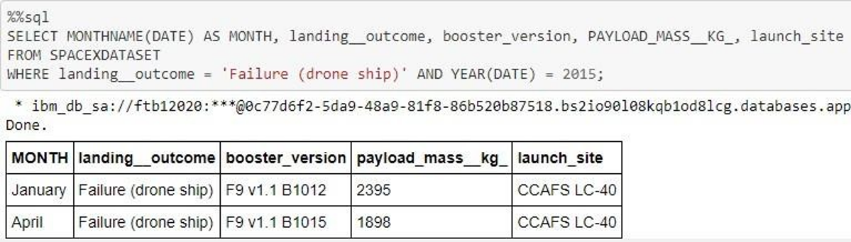
2015 Launch Records
This query returns the Month, Landing Outcome, Booster Version, Payload Mass (kg), and Launch site of 2015 launches where stage 1 failed to land on a drone ship.
There were two such occurrences.

Slide 33
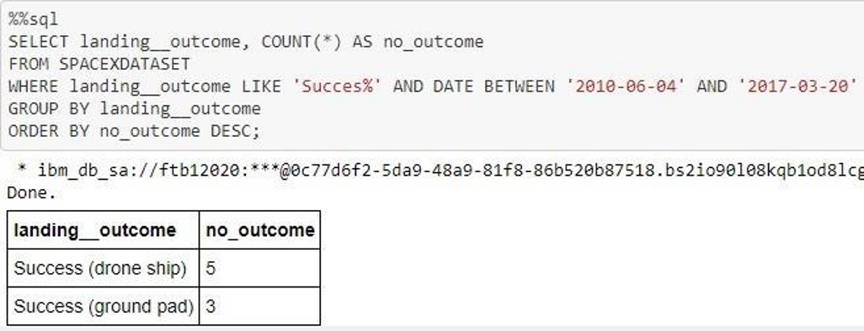
Rank Landing Outcomes Between 2010-06-04 and 2017-03-20
This query returns a list of successful landings and between 2010-06-04 and 2017-03-20 inclusively.
There are two types of successful landing outcomes: drone ship and ground pad landings.
There were 8 successful landings in total during this time period

Slide 34


Slide 35
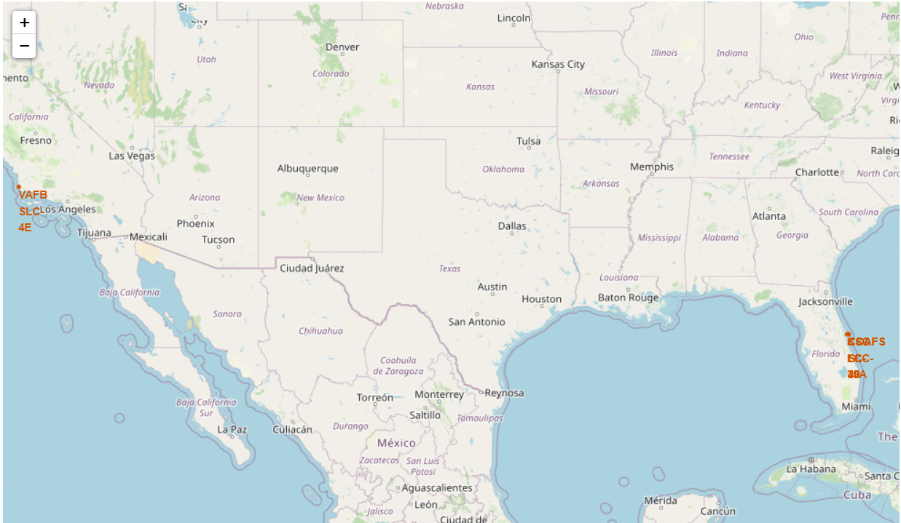
Launch Site Locations
The left map shows all launch sites relative US map. The right map shows the two Florida launch sites since they are very close to each other. All launch sites are near the ocean.

Slide 36
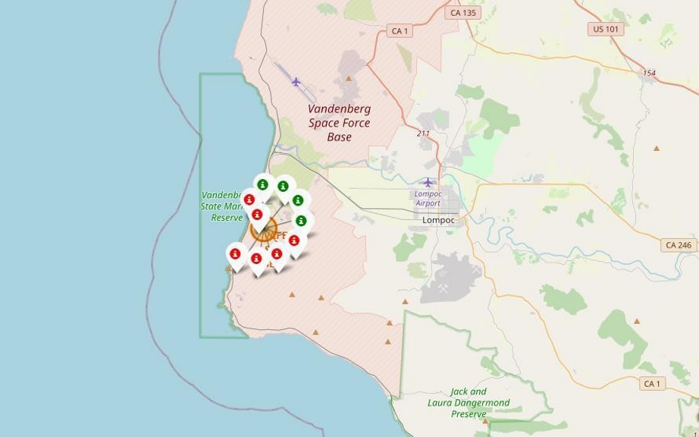
Color-Coded Launch Markers
Clusters on Folium map can be clicked on to display each successful landing (green icon) and failed
landing (red icon). In this example VAFB SLC-4E shows 4 successful landings and 6 failed landings.

Slide 37


Slide 38
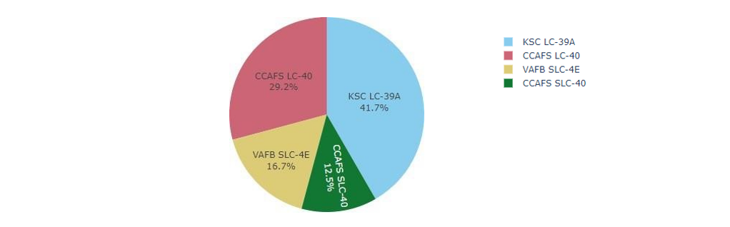
Successful Launches Across Launch Sites
This is the distribution of successful landings across all launch sites. CCAFS LC-40 is the old name of CCAFS SLC-40 so CCAFS and KSC have the same amount of successful landings, but a majority of the successful landings where performed before the name change. VAFB has the smallest share of successful landings. This may be due to smaller sample and increase in difficulty of launching in the west coast.

Slide 39
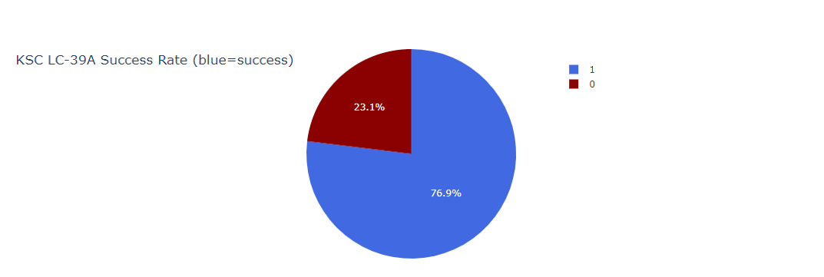
Highest Success Rate Launch Site
KSC LC-39A has the highest success rate with 10 successful landings and 3 failed landings.

Slide 40

Payload Mass vs. Success vs. Booster Version Category
Plotly dashboard has a Payload range selector. However, this is set from 0-10000 instead of the max Payload of 15600. Class indicates 1 for successful landing and 0 for failure. Scatter plot also accounts for booster version category in color and number of launches in point size. In this particular range of 0-6000, interestingly there are two failed landings with payloads of zero kg.

Slide 41


Slide 42
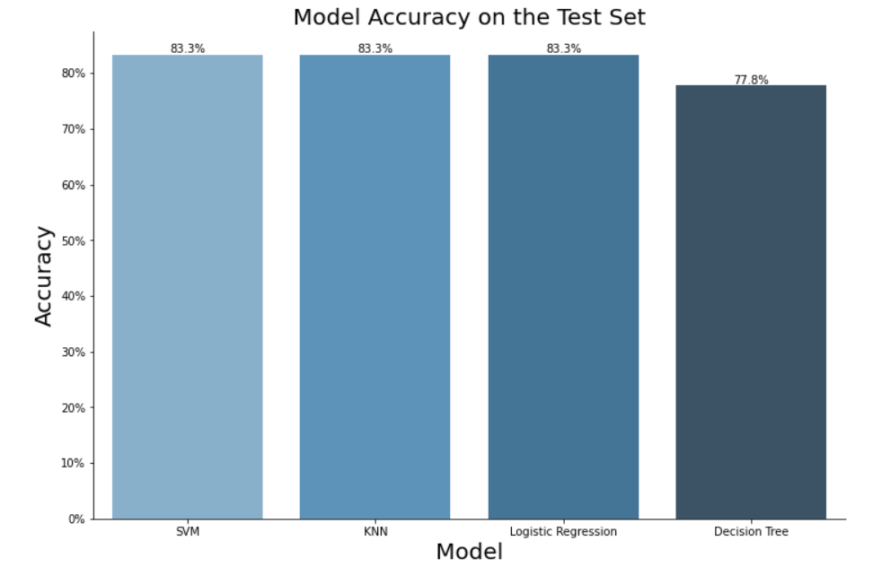
Classification Accuracy
Most of models have same accuracy except decision tree so we can choose on of (SVM, KNN, or Logistic Regression)

Slide 43
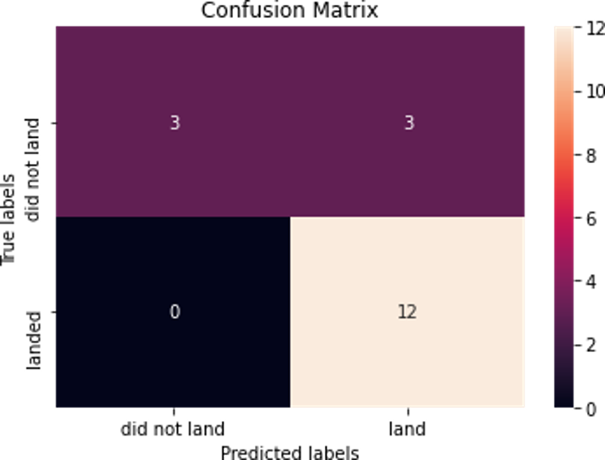
Confusion Matrix
Correct predictions are on a diagonal from top left to bottom right.
Since all models performed the same for the test set, the confusion matrix is the same across all models. The models predicted 12 successful landings when the true label was successful landing.
The models predicted 3 unsuccessful landings when the true label was unsuccessful landing.
The models predicted 3 successful landings when the true label was unsuccessful landings (false positives). Our models over predict successful landings.

Slide 44
Conclusions
Our mission: to create a machine learning model for Space Y to compete against SpaceX in a space race.Point 2
The model's purpose is to forecast when Stage 1 will successfully land so that $100 million can be saved.Point 4
Web scraped the SpaceX Wikipedia page and used data from a public SpaceX API.
Created data labels and stored data into a DB2 SQL database
Created a dashboard for visualization
We created a machine learning model with an accuracy of 83%
More data should be collected if at all possible in order to better establish the optimum machine learning model and increase accuracy.

Slide 45
Appendix
Github URL:
GitHub - bikawi/Applied-Data-Science-Capstone: In this repository you will find all labs provided by the IBM course with my solution, you can use it to widen your scope of the solution while you solving these labs

Slide 46


